Slide 1
EFT PAYMENTS
Automated

Slide 2
PRODUCT SYNOPSIS
UKZN required the automation of the paper-based “Yellow form”. One critical component of the form, is the Electronic Fund Transfer (EFT). Automating the form was to mitigate financial risks to the University.
The system ensures that the correct budget holder approves the transactions as per cost centre setup on iEnabler or ITS
The system allows for segregation of duties i.e. capturing and approving of banking details which was previously not done .
The main stakeholders stand to benefit from the automation by incorporating good financial practices, as prescribed by the Finance Division and guided by the prevailing policies and good governance processes.
The automated system validates against 3 subsystems which is PAYROLL, CREDITOR’S MASTERFIFLE and STUDENTS.

Slide 3
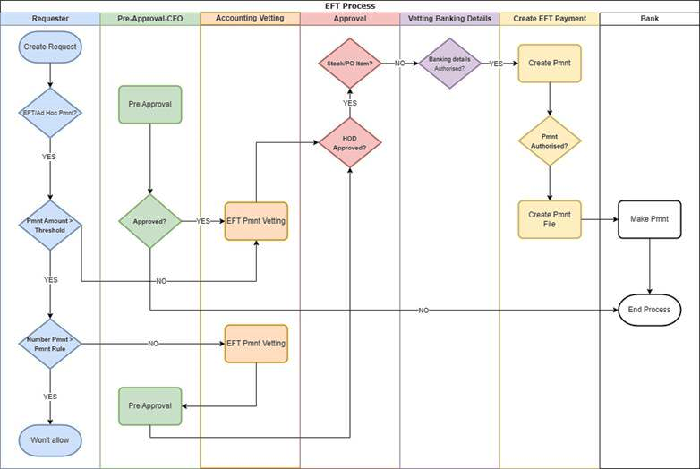
Process Flow

Slide 4
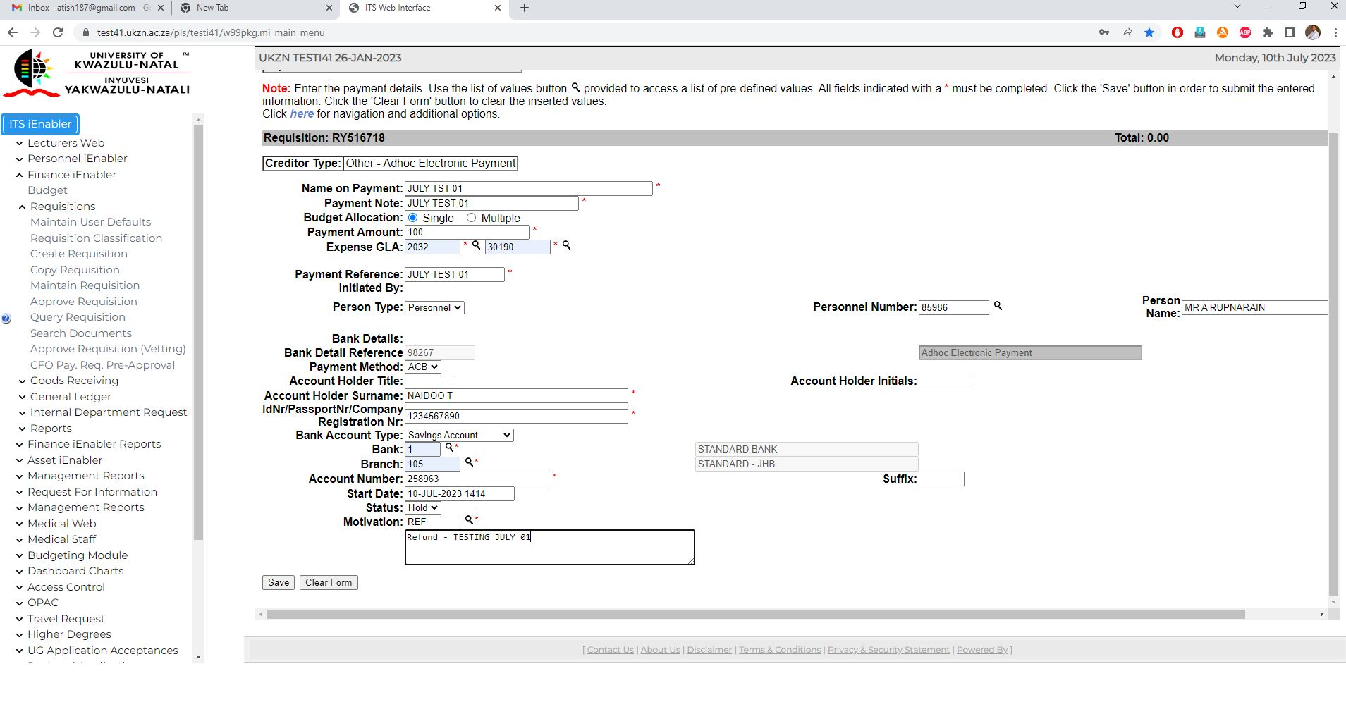
EFT PAYMENTS
REQUESTORS
(Administrators)
Create Payment Requisition and attach all supporting documents
as prescribed by the Institution guidelines( I Enabler)
Payment reference/document number mandatory to prevent
duplication.
Requisition Classifications
Routes to the Validator

Slide 5
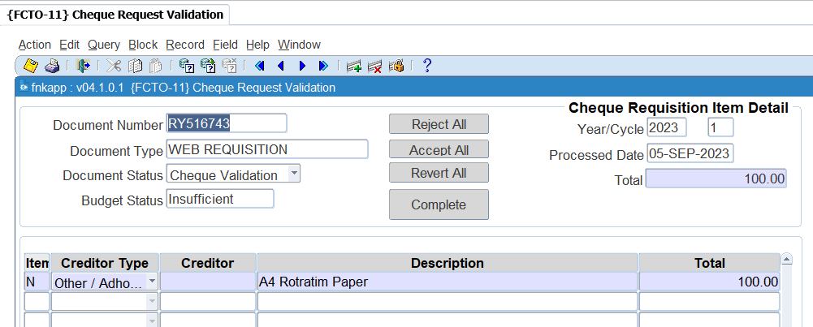
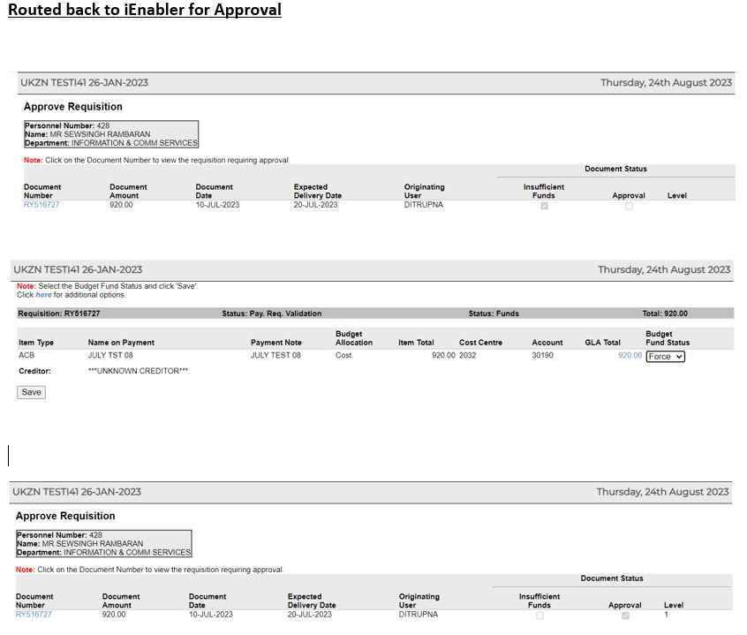
EFT PAYMENTS
VALIDATORS/VERIFICATION
(Accountant ) Set per cost centre
Validates Payment Request, checks for funds and override if the need arise also check VAT status (FCTO-11)
Maintain banking details ( On Hold Status) if incorrect reject and route back to requestor.
Routes back to I Enabler for approval

Slide 6
EFT PAYMENTS
APPROVERS
This was customized to suit UKZN approval set up
Email is received for awaiting requisitions linked to the approver
Requests less than (R350k) will be approved as per approval levels on I-Enabler.
Requests greater than R350k will route to the CFO or delegated authority for pre approval.
Number of payments is also defined at the back office per annum once it exceeds then it will route to CFO or delegated authority for approval.

Slide 7
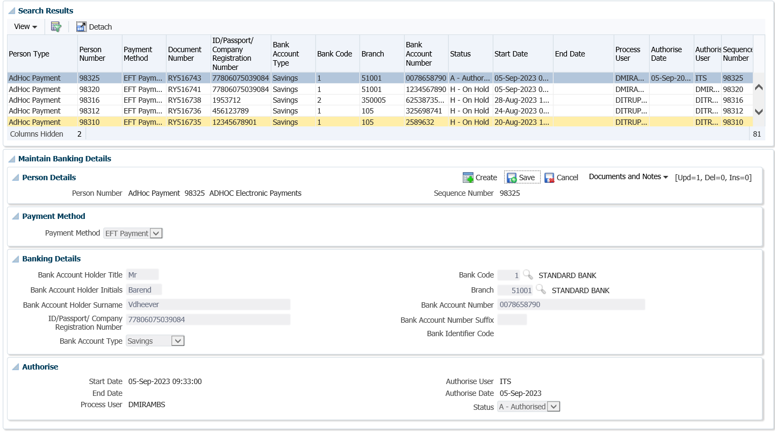
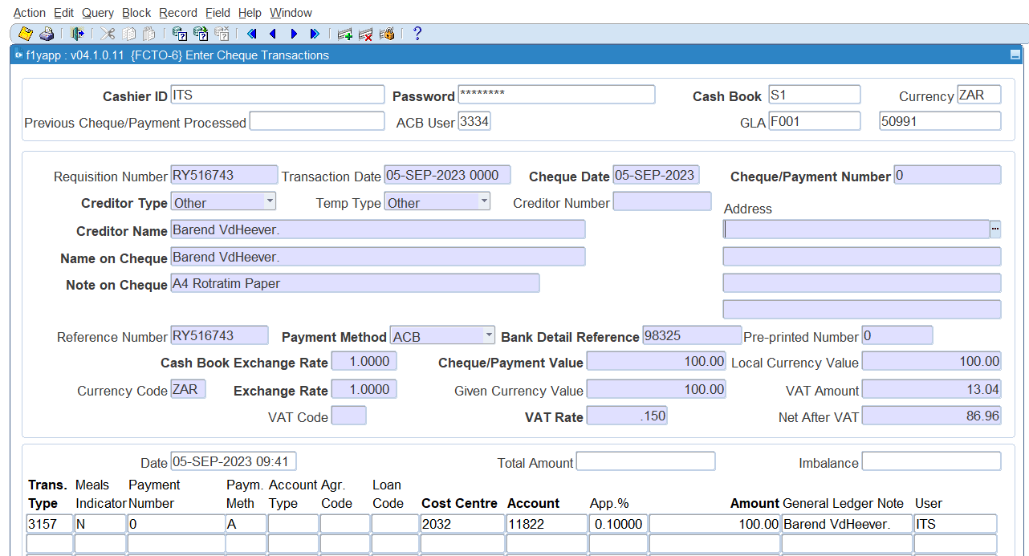
EFT PAYMENTS
ACCOUNTS PAYABLE
Check & Authorize Banking Details ( FCTM-10)
View documents & Create Payment (FCTO-6)
the user must have cashier ID.
Run ACB Tape File (FACBL-6)
( defined company code )

Slide 8
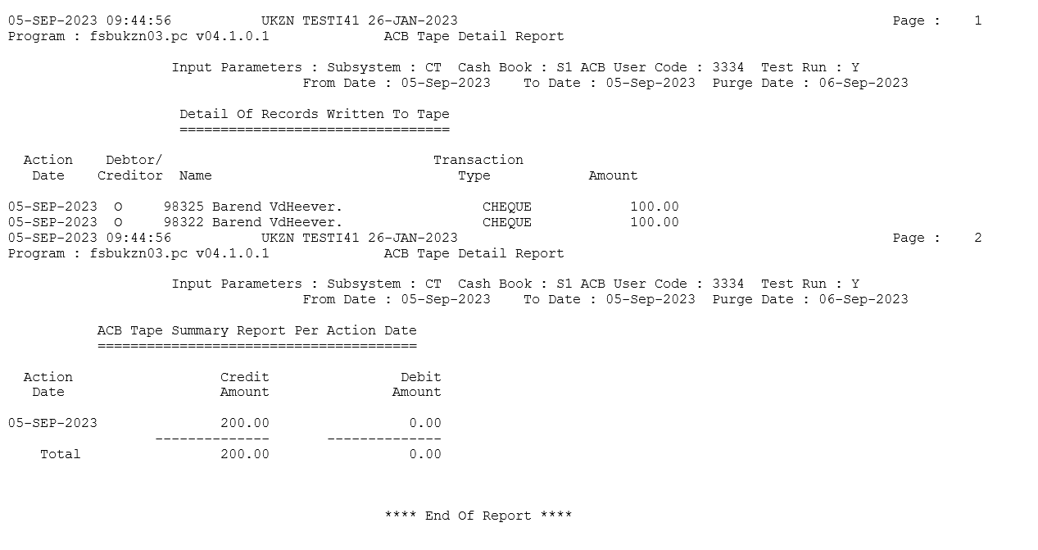
EFT PAYMENTS
Cont…
Run ACB Tape file. (FACBL-6)
ACB Tape cannot be generated if there are unapproved banking
details.
Upload the file to the bank as per set parameters.
Payment sent to Bank Releasers as per Authorization ranking set by Institution.
Generate remittance advice.

Slide 9
Q & A
THANK YOU!!!

